Slide 1
EE542 - Reading Assignment – 03 Generalized Window Advertising for TCP Congestion Control
Presenter: Boyang Xiao
USC id: 3326-7302-74
Email: boyangxi@usc.edu

Slide 2
Index
Paper’s main ideas
Generalized window advertising (GWA) TCP
GWA’s properties and modeling approximations
Buffer management policies
Comparison with traditional TCP implementations under various network conditions
Conclusions

Slide 3
Paper’s main ideas
Introducing a new approach to enhance TCP’s congestion controlling property: Generalized Window Advertising (GWA)
Analyzing GWA’s properties and performance under various networks conditions
Comparing GWA-TCP with traditional TCP congestions controlling performances

Slide 4
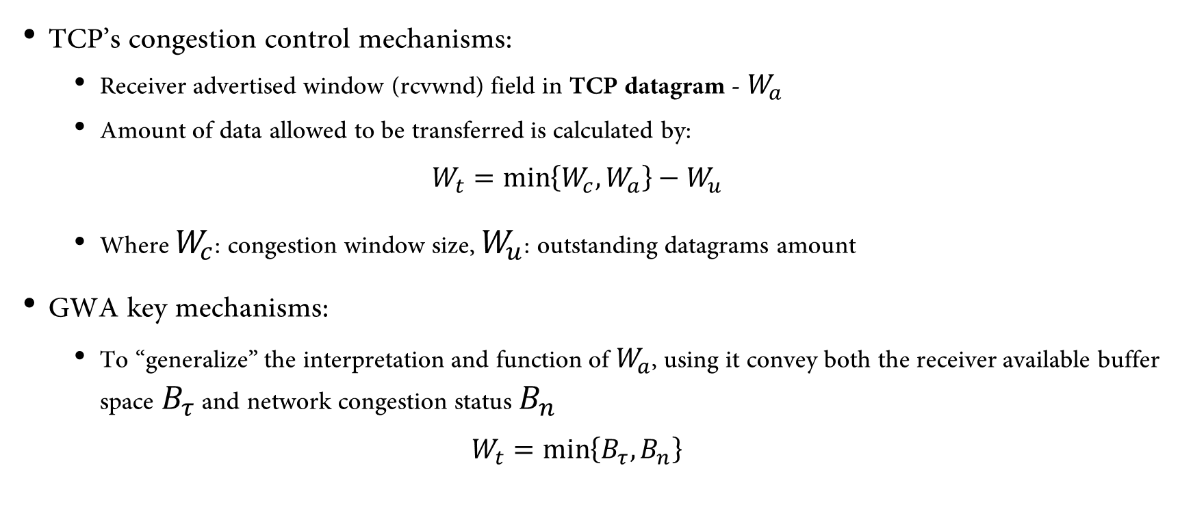
Generalized window advertising (GWA) TCP
TCP’s congestion control mechanisms:
Receiver advertised window (rcvwnd) field in TCP datagram - $W_{a}$
Amount of data allowed to be transferred is calculated by:
$$W_{t}=\min\left\{W_{c},W_{a}\right\}−W_{u}$$
Where $W_{c}$: congestion window size, $W_{u}$: outstanding datagrams amount
GWA key mechanisms:
To “generalize” the interpretation and function of $W_{a}$, using it convey both the receiver available buffer space $B_{τ}$ and network congestion status $B_{n}$
$$W_{t}=\min\left\{B_{τ},B_{n}\right\}$$

Slide 5



Generalized window advertising (GWA) TCP
GWA deployment in a simple network:
$$B_{n}=min⁡\{B_{n},B_{av}\}$$
$$B_{n}=\min\left\{B_{n},B_{av}\right\}$$
$$W_{t}=\min\left\{W_{c},W_{a}\right\}−W_{u}$$
$$W_{a}=min⁡\{B_{n},B_{τ}\}$$
Router1
Router2
Source
Destination
buffer
buffer

Slide 6
GWA’s properties and modeling approximations
GWA always ensures zero loss probability, regardless of the statistical fluctuations of the disturbances.
This means that there are no losses even if there is somewhere along the path where the bandwidth goes abruptly to zero.
The property can be rigorously verified in the model proposed in this paper, but the real system requires a reinterpretation of more properties:
TCP’s discrete behavior
The effect of transient TCP dynamics

Slide 7



Buffer management policies
Three buffer management policies applied to GWA-TCP
Routers with per-flow RR queuing discipline
Routers with FCFS queuing discipline
Bandwidth Aware Routers

Slide 8
Comparison with traditional TCP implementations under various network conditions
Comparison settings:
Extensions/modifications to the basic ns-2 infrastructure:
TCP dynamic window advertisement
Introduction of the optional field in the IPv6 header, plus the fields for BA-TCP Implementation of Eq.(2) in GWA-TCP receivers, and the additional control algorithm at the source in BA-TCP
Implementation of IP routers which advertise Bn or the available bandwidth vi
The 6 TCP implementations:
TCP-Reno and standard FCFS queuing IP routers, in the sequel named Drop-Tail
TCP-Reno and RED IP routers, named RED
TCP-Reno with ECN (Explicit Congestion Notification) capabilities and tagging RED IP routers, named ECN
TCP-Reno with GWA capabilities and per-flow queuing, RR IP routers, named GWA-RR
TCP-Reno with GWA capabilities and FCFS queuing IP routers, named GWA-FCFS
TCP-Reno with Bandwidth Aware GWA capabilities; FCFS IP routers capable of measuring the available bandwidth, named BA-FCFS.

Slide 9
Comparison with traditional TCP implementations under various network conditions
LAN environments:
Any GWA algorithm ensures perfect fairness and full utilization even with small router buffer size
With GWA-FCFS, both the average and the maximum delay increase with buffer size, since the aggregate queue stabilizes to a higher value when the buffer is large. BA-FCFS yields negligible delays since it drives the overall queue length to zero. ECN Telnet delays are also very low.
GWA schemes exhibit very stable behavior, without packet drops even during the initial transient.

Slide 10
Comparison with traditional TCP implementations under various network conditions
WAN environments:
The fairness improvement as the buffer size increases for GWA-FCFS is explained by the increased buffer occupancy and therefore increased round trip time (RTT) seen by TCP sources.
The throughput performance is consistent with the packet loss and delay for GWA-TCP.
GWA transient behavior is quite good, although a high frequency ripple is noted, especially with the RR discipline.
Both GWA implementations perform remarkably well in a “many flows” situation, with full link utilization and perfect fairness.
GWA-FCFS fairness improves when increasing the number of active connections and reducing the available bandwidth.

Slide 11
Conclusions
Conclude GWA definitions and dependencies:
The GWA algorithm presented a new approach to TCP congestion control.
The scheme relies on the cooperation between IP network entities (routers) and host based TCP entities.
The window control algorithm is based on a classical control theory approach known as Smith Predictor.
GWA advantages over traditional TCP:
GWA in general attains a more stable network operation as well as a higher degree of fairness.
It guarantees a loss free operation as predicted by theory.
Throughput performance depends on propagation delays and router buffer size; in typical operating conditions, GWA ensures full link utilization.
GWA’s Compatibilities
GWA is backward compatible with all TCP versions. Namely, GWA- and non-GWA TCP hosts can always communicate with each other.

Slide 12
Thanks for watching!
Presenter: Boyang Xiao
USC id: 3326-7302-74
Email: boyangxi@usc.edu

